Slide 1

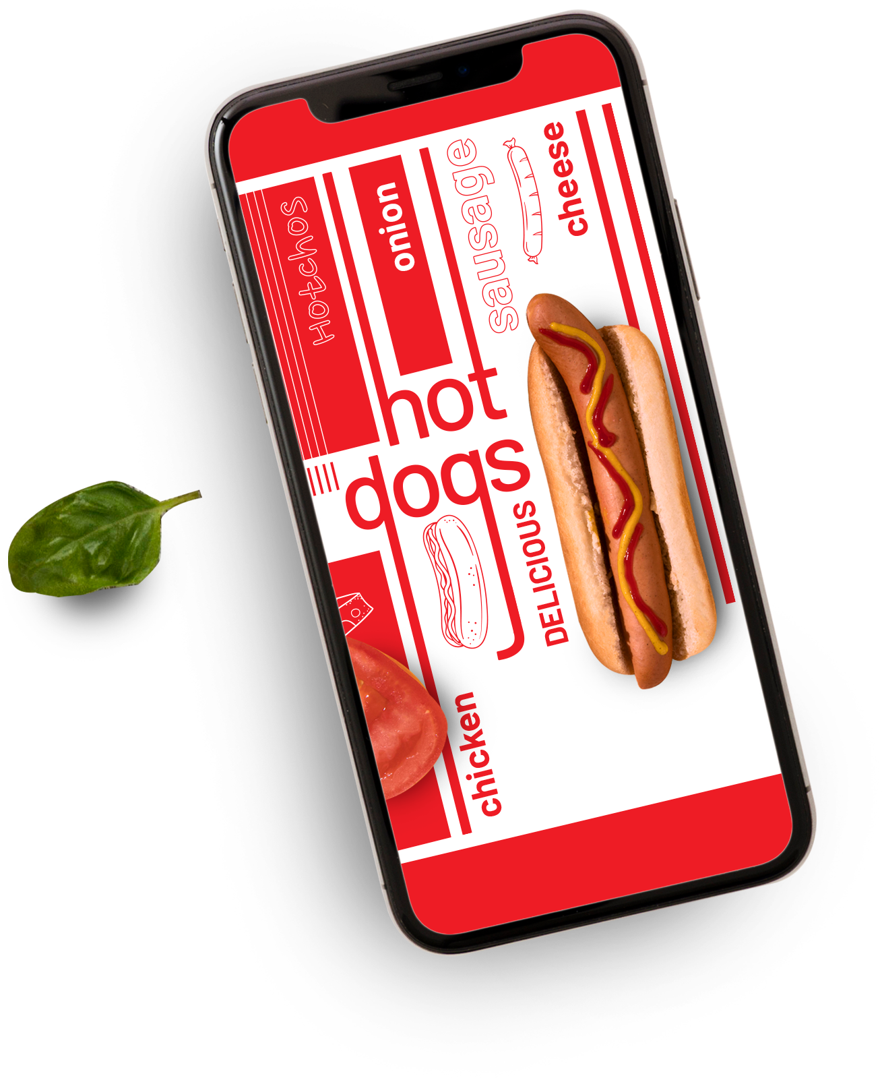
Zomato DATA ANALYTICS PROJECT
Group-2

Slide 2

AGENDA
1
INTRODUNCTION
2
DATA OVERVIEW
3
OBJECTIVES : KPIs
4
ANALYSIS
5
RECOMMENSATION
6
INSIGHTS AND CONCLUSIONS

Slide 3



INTORDUCTION
Content:
Project Focus: Analysis of Zomato's 2024 restaurant data, covering 15 countries and 141 cities.
Objective: Evaluate geographic reach, sales performance, and customer engagement.
Scope: 9,551 restaurants analyzed, with insights on ratings, sales, and online delivery trends.
Goal: Identify growth opportunities and enhance decision-making through data-driven insights.
Visuals:
Zomato logo or a food-related graphic for a professional touch.

Slide 4

DATA OVERVIEW
Dataset Summary:
Total Restaurants: 9,551
Countries Covered: 15
Cities Covered: 141
Time Frame: Data spans multiple years (2010–2018).
Key Data Points:
Total Sales: ₹11M, reflecting the revenue from Zomato restaurants.
Customer Feedback:
Average Rating: 2.89
Average Votes: 157
Pricing Categories: Restaurants are distributed into different price buckets, ranging from ₹0 to ₹10,000+.
Geographical Coverage:
India leads with 8,652 restaurants, followed by other countries like the USA, UK, and Brazil.
Sales Insights:
Sales by Day Type:
Weekdays contribute 77.91% of sales.
Weekends contribute 22.09%.
Online Delivery: Only 25.66% of restaurants offer online delivery.
Visuals to Include:
A combination of cards and charts from the dashboard:
Cards: Key metrics (e.g., total restaurants, sales, countries, cities).
Bar Chart: Country-wise restaurant distribution.
Donut Chart: Sales by day type or online delivery availability

Slide 5

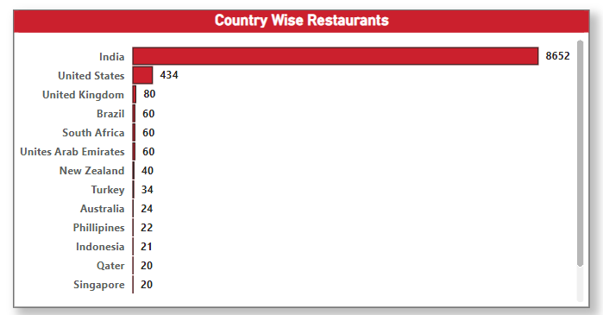
COUNTRY –WISE RESTUARANTS
(ANALYSIS)
Global Presence: Zomato operates in 15 countries and 141 cities, with India leading with 8,652 restaurants, contributing over 90% of the total.
Key Markets: Countries like the USA (434 restaurants), UK (80), and Brazil (60) show notable presence but room for growth.
City-Wise Analysis: The dashboard includes a filter to analyze restaurants at the city level, allowing detailed exploration of key markets.
Growth Opportunities: Significant potential exists for expansion in underrepresented regions like Europe, Africa, and Australia.
Insight: Zomato's heavy reliance on India highlights its strength but also indicates the need for global diversification.

Slide 6
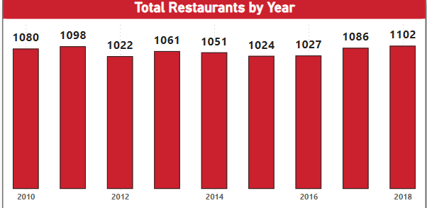
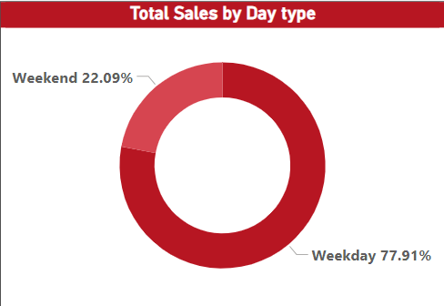
Total Restaurants by Year
Steady Growth: The total number of restaurants has increased consistently from 1,080 in 2010 to 1,102 in 2018, indicating stable growth over the years.
Peak Years: Notable growth occurred between 2014 and 2016, showing effective expansion strategies during this period.
Market Penetration: The steady addition of restaurants reflects Zomato's ability to onboard partners and expand its footprint globally.
Total Sales by Day Type
Weekday Dominance: Weekdays contribute the majority of sales, accounting for 77.91%, showcasing higher customer engagement during workdays.
Weekend Sales: Weekends make up 22.09% of sales, indicating opportunities to boost sales through weekend-specific promotions or events.
Key Insight: The data suggests focusing marketing efforts on weekdays while creating strategies to drive higher weekend traffic

Slide 7
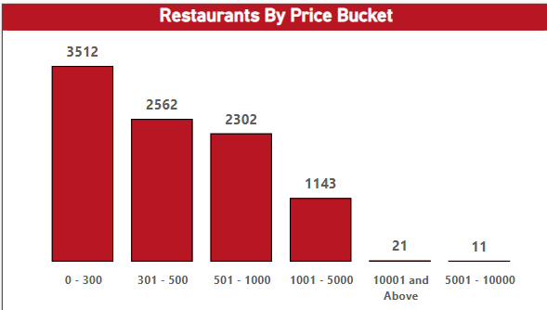
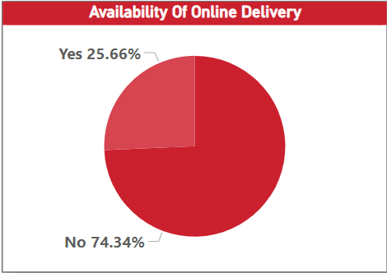
Restaurants by Price Bucket
Affordability Focus: The majority of restaurants (3,512) fall in the ₹0–₹300 price range, highlighting Zomato's emphasis on budget-friendly options for a wider customer base.
Mid-Range Popularity: ₹301–₹500 is the second most common price range (2,562 restaurants), indicating a strong presence in the mid-range dining segment.
Limited High-End Options: Only 32 restaurants fall into the ₹1,000+ category, showing a potential area for growth in premium dining experiences.
Availability of Online Delivery
Limited Online Delivery: Only 25.66% of the restaurants offer online delivery, highlighting a significant gap in service availability.
Growth Opportunity: The large percentage of restaurants without online delivery (74.34%) presents an opportunity for Zomato to expand its delivery services.
Strategic Focus: Expanding online delivery options can increase customer reach and sales, especially in areas where demand for delivery services is growing.

Slide 8
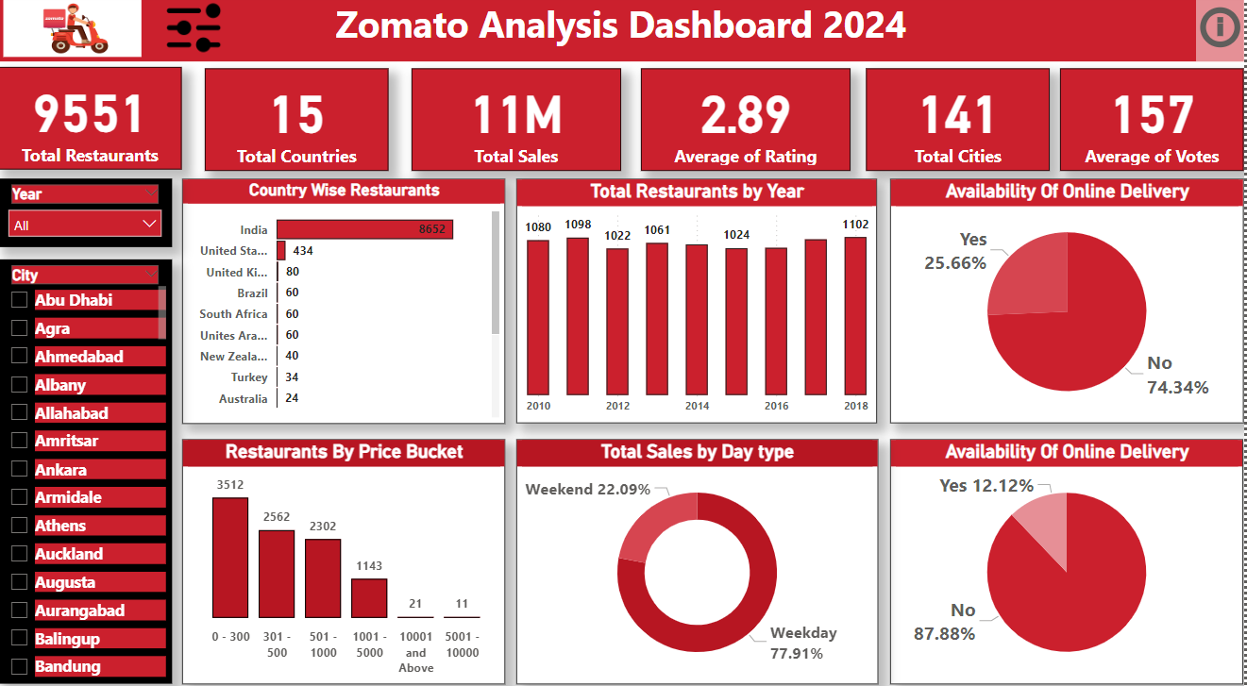

Slide 9

Recommendations
Expand Online Delivery Services:
"With over 74% of restaurants not offering online delivery, there's a significant opportunity to partner with more restaurants to offer this service. This can attract a larger customer base and increase revenue."
2. Enhance Customer Experience:
"With an average rating of 2.89, it's important to improve customer satisfaction. This can be achieved by addressing delivery delays, improving food quality, and enhancing user experience on the app."
3. Target Weekend Sales:
"Since weekends account for only 22% of sales, Zomato can run targeted weekend promotions or campaigns to boost sales during this time. Discounts or loyalty rewards can encourage more orders."
4. Diversify Restaurant Pricing:
"Most restaurants cater to lower price ranges (₹0–₹500), but adding more premium options can help attract high-income customers, diversifying the customer base."

Slide 10


Conclusion
Key Takeaways:
"India leads Zomato’s operations, with the majority of restaurants located here. Sales are stronger on weekdays, and budget-friendly options dominate the platform."
"However, online delivery is underutilized, and customer ratings indicate the need for improved service quality.“
Final Remarks:
"By focusing on expanding online delivery, boosting weekend sales, and improving customer experience, Zomato can strengthen its position and drive future growth."

Slide 11

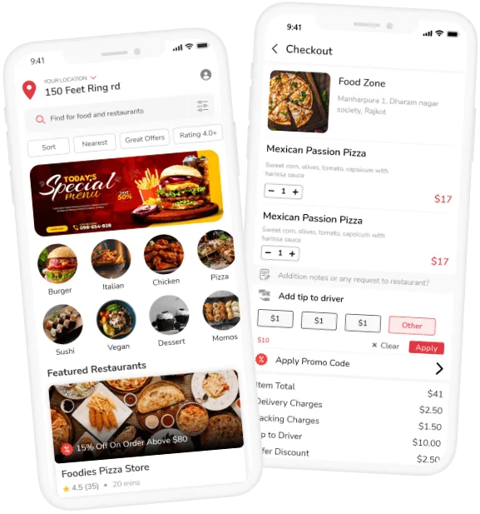
Thank You

